Slide 1
7 Random Numbers
Ref: Law & Kelton, Chapter 7
JPC & JTB 2002

Slide 2
Random Numbers
Generating random numbers is important for all simulations (and for a number of other applications).
We can generate random numbers physically by:
  Rolling a (fair) die
  Picking a number from a hat
  Spinning a roulette wheel
Generating random numbers numerically, however, is impossible.
What we can do is generate a sequence of numbers that appears to be random and has a number of good characteristics.
JPC & JTB 2002

Slide 3
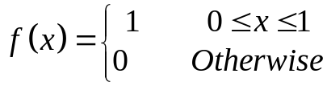
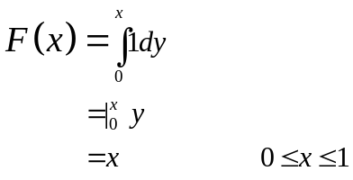
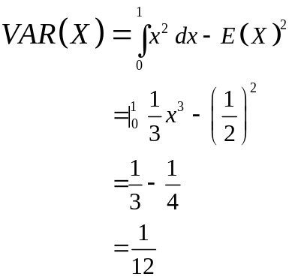
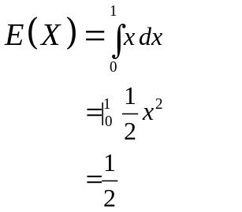
Properties of Random Numbers
f(x)
1
0
1
x
JPC & JTB 2002

Slide 4
Properties of Random Numbers
Random numbers should be uniformly distributed and independent.
Uniformity: If we divide (0,1) into n equal intervals, then we expect the number of observations in each sub-interval to be N/n where N is the total number of observations.
Independence: The probability of observing a value in any sub-interval is not influenced by any previous value drawn.
JPC & JTB 2002

Slide 5
Good Properties
Since we cannot generate “true” random numbers we want to generate a sequence of numbers with the following properties:
    Speed – the algorithm must be quick.
    Portable – easily moved between different hardware and software.
    Long cycle (period) – the sequence generated should repeat itself
    Repeatability – it must be possible to recreate the sequence of numbers (typically for different scenarios).
    Statistical properties – the generated numbers must be able to pass tests for uniformity and independence.
JPC & JTB 2002

Slide 6


Linear Congruential Generators
Oddly enough, the mechanism for generating a random number stream is fairly simple.
We generate a stream of numbers [0,m)
mod is the modulo operator (i.e. 11 mod 3 = 2)
And we convert these to a number [0,1):
JPC & JTB 2002

Slide 7
Example 1
X₀ = 27
a = 17
c = 43
m = 100
X_{i+1} = (aX_{i}+c) mod m
= (17X_{i}+43) mod 100
X₁ = (17*27 + 43) mod 100
= 502 mod 100
= 2
R₁ = X₁/m
= 2/100
= .02
X₂ = (17*2 + 43) mod 100
= 77 mod 100
= 77
R₂ = X₂/m
= 77/100
= .77
JPC & JTB 2002

Slide 8
Some Notes on LCGs
X₀ is called the “seed”
If c <> 0, this is called a mixed congruential generator.
If c = 0, this is called a multiplicative congruential generator.
JPC & JTB 2002

Slide 9
How Good are LCGs?
In our example R_{i} is an element of {1/m, 2/m, …, m-1/m}
Thus, we cannot generate all numbers (0,1).
Furthermore, the period of our generator is short. (At best we could get a maximum period of 99 before repeating).
If, however, we select very large values of m, we can get a good approximation to U(0,1).
Furthermore, if m is large (2³²-1 or 2⁴⁸) we can (hopefully) get a period in the range of 2*10⁹.
However, the performance of LCGs is highly dependent on good choices of a, c, and m. There have been several notoriously bad implementations of LCGs.
JPC & JTB 2002

Slide 10
Periods
If m = 2^{b} (typically 2³²-1 or 2⁴⁸ depending on implementation).
If a = 1+4k, where k is a positive integer.
If c <> 0 and is relatively prime to m (i.e. largest common denominator is 1
Period = 2^{b} = m
If m = 2^{b} (typically 2³²-1 or 2⁴⁸ depending on implementation).
a = 3+8k OR 5 +8k, where k is a positive integer.
c = 0 & X₀ is an odd number
Period = 2^{b-2} = m/4
If m is prime.
If a has the property that the smallest integer k such that a^{k}-1 is divisible by m is k= m-1.
c = 0
Period = m-1
It is easier to do modulus operations with m = 2^{b}, so in general, we conclude that LCGs offer the potential for longer periods than do MCGs.
JPC & JTB 2002

Slide 11
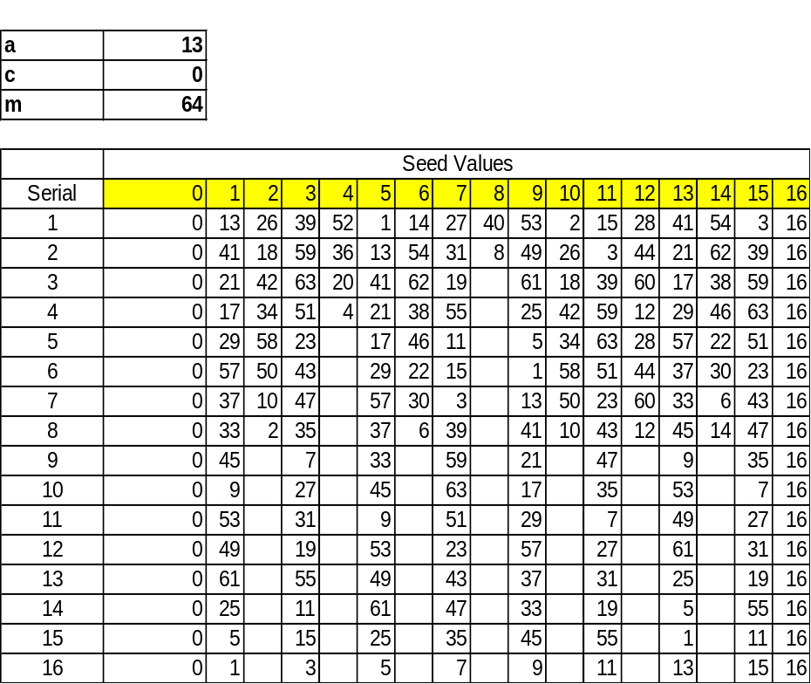
Example
Assume we select m = 2⁶=64, c=0, a= 13 (of form 5+8k). The maximum period should be m/4 = 16, depending, of course, on our choice of X_{0.}
Note the short period (16).
The choice of seed does affect the period!
Look at the gaps in the sequence even for a long period. If we look at X₀ = 1 we see the sequence comes from the set {1, 5, 9, …61}. There are large gaps in our sequence!
JPC & JTB 2002

Slide 12
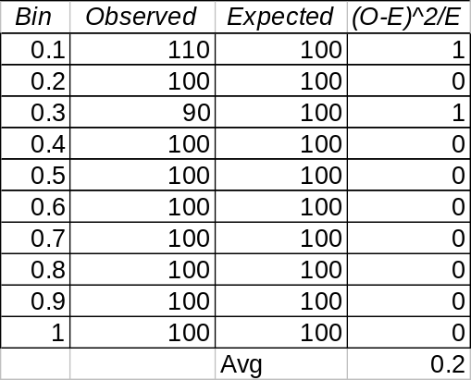
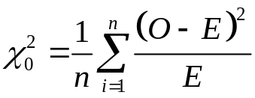
Testing Uniformity: Chi-Squared
Divide U(0,1) into a number of equal sub-intervals.
Generate a number of samples on U(0,1).
Count the number of observations in the sub-interval.
Check this against the expected number of observations.
For example, assume:
  X₀ = 1
  a = 11
  c = 3
  m = 101
Assume 10 sub-intervals and 1000 observations.
Assuming an α of 0.05, the critical value for X_{.95, 9} is 16.919. Thus our generator passes a uniformity test.
JPC & JTB 2002

Slide 13
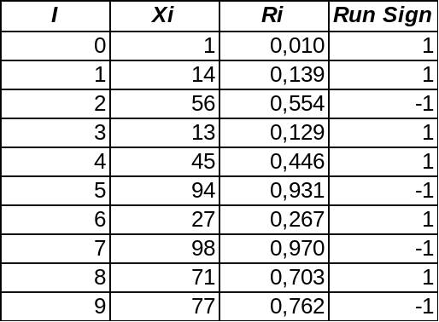
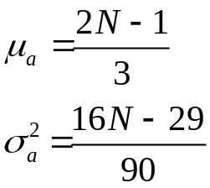
Testing Independence: Runs Test*
I have produced the 1st 10 random numbers for our example generator.
In the 4th column, a 1 indicates that the number is followed by a higher number; a –1 indicates that the following number is lower.
A series of “1”s or “-1”s is called a run.
If a is the total number of runs in a random sequence then:
* From Banks and Carson
JPC & JTB 2002

Slide 14
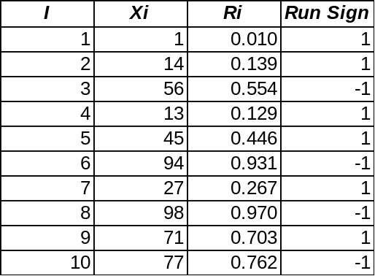
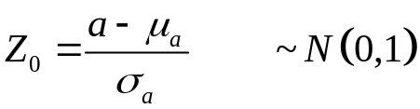
Testing Independence: Runs Test*
If a is the total number of runs in a random sequence then:
where N is the number of observations (1000 in our case).
Then:
In our example:
Expected runs (μ_{a}) = (2(1000)-1)/3
666.33
σ_{a}² = (16(1000)-29)/90 = 177.45
The actual number of runs was observed to be 620.
* From Banks and Carson
JPC & JTB 2002

Slide 15
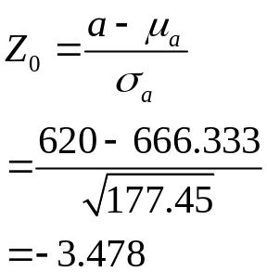
Testing Independence: Runs Test*
H₀: The generator produces independent samples.
H₁: The generator does not produce independent samples.
If -z_{α/2} <= Z₀ <= z_{α/2} where α is the significance level, we will accept H_{0.}
The critical value for z_{.025} is 1.96.
Thus, we reject H₀ and assume that our sample is not independent.
NB: Other types of runs tests are available.
JPC & JTB 2002

Slide 16
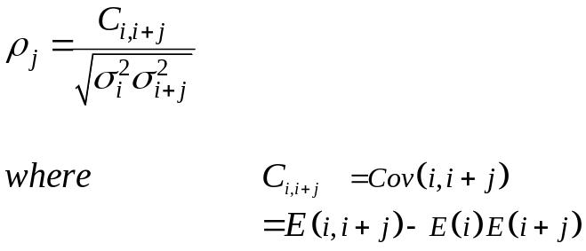
Testing Autocorrelation
Test the correlation between the i^{th} and the i+j^{th} random numbers.
For example if j = 2, we would check the correlation between the 1st and 3rd numbers, the 2nd and 4th, …
j is sometimes called the lag.
ρ_{j} is called the autocorrelation
JPC & JTB 2002

Slide 17
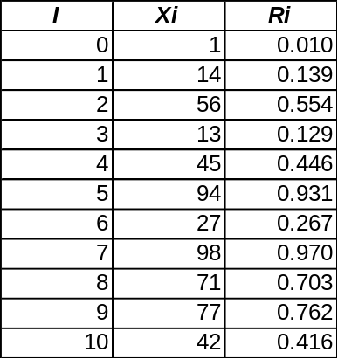
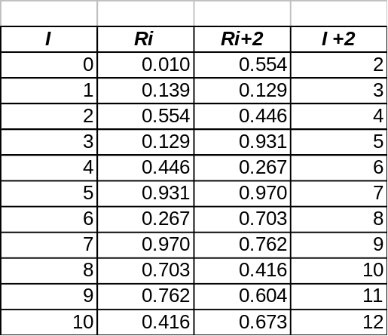
Autocorrelation Example
Consider our example
And our sample with a lag of 2
Based on the 1st 100 random numbers:
E(Ri) = 0.499; E(Ri+2) = 0.506; E(Ri, Ri+2) = 0.250
s(Ri) =. 290 s(Ri+2) = .287
C(Ri,Ri+2) = . 250 -(.499)(.506) = -0.0022
ρ₂ = -0.026*
*A approximate calculation of rho and significance test for autocorrelation is found in L&K in Section 7.4.1
JPC & JTB 2002

Slide 18
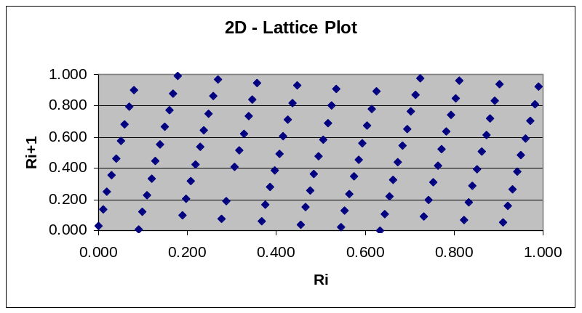
Lattice Plots
RNG tend to produce numbers that fall on hyperplanes.
If the number of hyperplanes is small, or there are large gaps between the hyperplanes, then the RNG is likely to be poor.
Plots of (Ri, Ri+1) produce something called a lattice plot.
Using our example generator, we see that the resulting numbers do have a number of large gaps.
JPC & JTB 2002

Slide 19
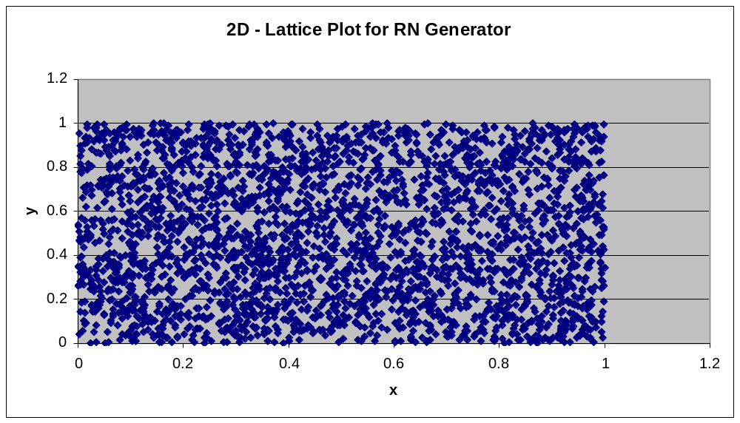
Lattice Plot: Excel’s RNG
JPC & JTB 2002

Slide 20
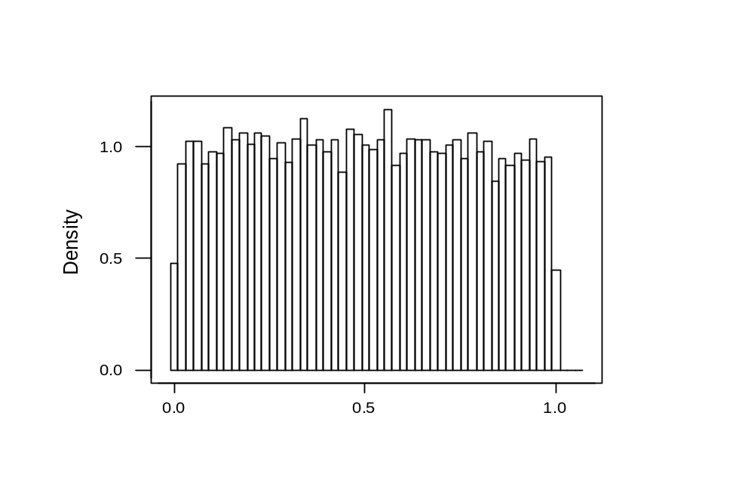
Histogram
JPC & JTB 2002

Slide 21
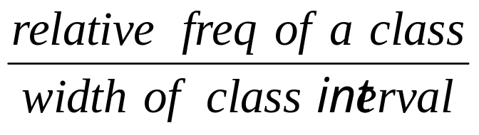
Histogram
To draw a relative frequency histogram, the class interval are marked on the horizontal axis of a graph. On each interval a vertical rectangle is then drawn whose area is equal to the relative frequency of that interval
Height of a rectangle =
This is because the area of a rectangle = height x width
JPC & JTB 2002

Slide 22
Histogram
Measurement of Ozone Concentration (in Parts Per Hundred Millon) in LA
3.5 6.8 2.4 6.8 5.5 6.2 5.7 9.4 6.8 6.6
1.4 2.5 3.0 1.7 1.1 7.5 5.8 3.4 3.1 4.4
6.6 5.4 5.6 5.3 5.1 6.2 3.1 5.8 4.7 5.7
6.0 4.4 4.7 4.7 5.6 6.0 5.8 7.6 3.8 4.5
4.2 5.4 6.5 7.4 5.5 5.8 1.6 1.4 5.9 3.7
4.4 4.7 3.0 6.0 1.4 2.8 2.5 3.7 3.3 9.4
5.3 3.5 4.1 6.7 3.9 6.1 8.1 2.0 6.2 5.6
4.0 3.4 11.7 6.6 4.1 6.6 3.7 7.6
JPC & JTB 2002

Slide 23
Histogram
Example (number of interval : 6)
Class interval | Freq | Relative freq
0.05 - 2.05 | 7 | 0.090
2.05 – 4.05 | 19 | 0.244
4.05 – 6.05 | 31 | 0.397
6.05 – 8.05 | 17 | 0.218
8.05 – 10.05 | 3 | 0.038
10.05 – 12.05 | 1 | 0.013
Total | 78 | 1.00
JPC & JTB 2002

Slide 24
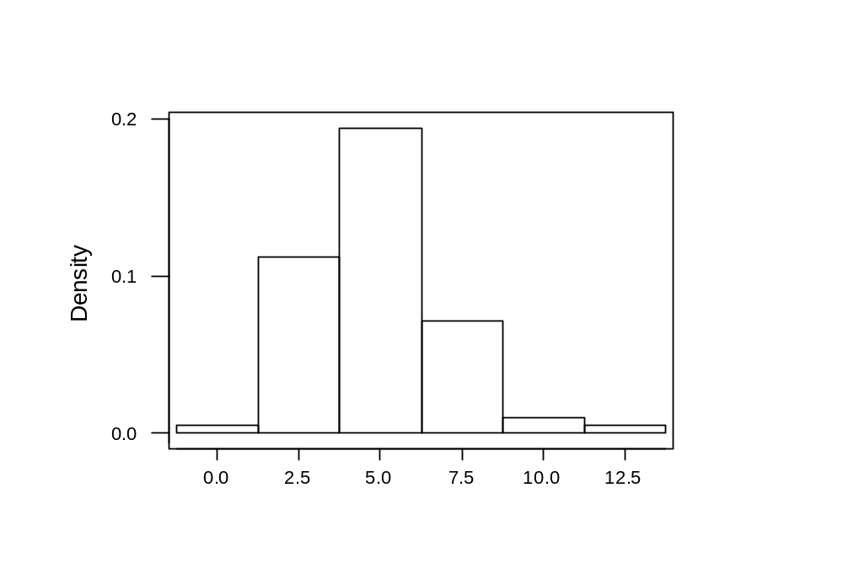
Histogram
JPC & JTB 2002

Slide 25
Middle Square
i | Z_{i} | U_{i} | Z_{i}²
0 | 7182 | - | 51,581,124
1 | 5811 | 0.5811 | 33,767,721
2 | 7677 | 0.7677 | 58,936,329
3 | 9363 | 0.9363 | 87,665,769
JPC & JTB 2002

